Slide 1
Innercity s o f t w a r e
Company Overview
Interactive Architect
ASP and e-Business Accelerator

Slide 2
Innercity
s o f t w a r e
Summary
Mission
Objective
Products
Marketing
Organization
Close

Slide 3
Ken Granderson:
What is ‘Brand Consulting?”
Innercity
s o f t w a r e
Summary
innercity software (ICS) seeks to establish strategic alliances and affiliations to expand its business. ICS is an internet architect, a firm that combines new and legacy technology skills with strategic and brand consulting that acts as a web enablers. We can develop and implement e-solutions. As the only minority-owned and operated firm in this space, ICS is uniquely positioned to exploit a full range of opportunities in the private, public and non-profit sectors.
ICS proposes a strategic alliance with FleetBoston’s First Community Bank to increase the penetration of its electronic banking, bill presentment, lending and retail banking products in the minority e-business, non-profit and public sector in the northeastern market.
This summary provides company data in advance of a formal proposal.

Slide 4
innercity mission
InnerCity Software (ICS) will become the "Motown" of the Internet create a a powerful cross-media brand . ..TV, Radio, Publishing, and Internet
By Harnessing the creativity, business skills and technical talent of black software developers and consultants ICS will provide cutting edge products and services while retaining the wealth creation in the inner city. ICS’ “assembly-line” approach will pool minority creative talent to better serve and represent the black community and interest groups by providing technology, incubation, services and content to take a business from concept to launch in Internet time.

Slide 5
Ken Granderson:
sub=sub-contractor?
innercity
Objectives
Become the largest Black Owned Web-enabler (Internet Architect) generating $10 million in revenues within 18 months;
Complete development of BlackPeople.com and increase weekly site visits from 128,000 to 4 million by September 2000;
Provide Development and Management Services to 3 major black brands in 2000;
Secure 2 Enterprise Zone Information Projects with E-Commerce components;
Secure 2 major Strategic Alliances with technology firms as a sub for implementation and training, and;
Expand staff from 6 to 21 professionals by September, 2000.

Slide 6
innercity
Company History
Founded in 1992, privately held, C-Corp, specializing in the development and implementation of leading edge internet applications. The company is an Minority Business Enterprise and operates from its offices in Dorchester, Massachusetts.
Inner City Software Projects since 1992
  Operates Boston’s #1 e-mail discussion group for blacks, Boston Blacks Online
  Designed and developed Black Facts Online, Black History CD ROM, New England Black Pages Online
  Inner City Software’s Press includes: Black Enterprise, Ebony Man, NY Times, Washington Post, Boston Globe, Boston Herald, All Major Network Television News in Boston
  CEO received honorary doctorate form Salem State College in 1999 in recognition for his leadership and vision in bringing communities of color into the Information Age
Launching Enterprise Zone Web-site, 2000
Entrepreneur of the year award 1999
Microsoft Developer Award

Slide 7
innercity
Technology Staff
Kenneth Granderson - Founder, Managing Partner
  CEO of Inner-City Software since 1992; Board of Directors Freedom House and Urban League of Eastern Mass; MIT, BS, Computer Science; five years of Black online community building on CompuServe and the Internet, along with its technical expertise in building online community technology; MIT Community Fellow; Honorary Doctor in Humane Letters from Salem State.
Martin Welch - Partner, Lead Interactive Developer
  Software Engineer for 9 Years; Born, raised and currently residing in Boston area, Martin Welch is ICS’ Senior Analyst. Self-taught Martin specializes in dynamic intra/internet application development enterprise class database development and desktop application development.
Randall Pinkett - Advisory Software
  Ph.D. Candidate, MIT Media Lab; MIT, MBA and MS Electrical Engineering; Rhodes Scholar, MS Computer Science, University of Oxford. Research focused on technology and African-Americans; worked at AT&T Bell Laboratories; President and CEO of MBS Enterprises, an educational services and training firm that targets African-Americans.

Slide 8
innercity
Consulting Staff
Luis Barros - Managing Partner
  12 years of sales, mktg, business development in high-tech; MIT, MBA; Adjunct E-Commerce Professor @ UHartford. Prior experience in launching 3 e-commerce entities; Has consulted several leading media organizations on various aspects of e-commerce and internet marketing, including one of Internet’s leading portals; Co-author of published paper on B2B e-commerce and B2C personalization and portal strategy. Advisory Board of 2 dotcoms: ZipLip.com and Uhe@rd.com.
Dino Browne - Partner (Contingent)
  10 years of business development consulting in high-tech as a Principal for DiamTech; MIT, BS; Experience launching 10 e-businesses for large businesses; Has consulted several leading business organizations on various aspects of e-commerce and internet marketing, including one of Internet’s leading portals.
Christopher Aldridge - Partner, Counsel
  10 business development, brand management experience. BA Harvard, JD Wayne State Developed a multi-billion dollar virtual insurance business for Ford. Developed private label branding program that became leading product within the $14 billion retail insurance market.

Slide 9
innercity
Marketing Strategy
E-Business Enabler
  Leverage Developers on Line to Capture New Initiatives.
  Work strong MIT, Harvard and Microsoft relationships to secure inside track on business opportunities.
  Establish Strategic Alliances with service providers to provide one stop shop for businesses and entrepreneurs.
Public Sector Work
  Exploit MBE status to secure Federal work
  Use previous Non-profit work to “create” product opportunities through private public partnerships

Slide 10
innercity
Product Service Summary
Interactive Integration/Consulting (3 professionals, grow to 25)
  Advanced Chat Technology
  E-Commerce Implementation
  Electronic Magazine Products
  Hosting
Strategic Consulting, Brand Management (3 professionals, grow to 10)
  Marketing & Business Plans
  Site Design and Business integration
  Temporary Management Teams

Slide 11

innercity
Current Projects: EZ Info Zone
Boston Enterprise Zone Data Base
  Projects & Programs
  Contacts
  Help Inquiry
Developed and Hosted by ICS
May expand to include lender contacts and lien information.
In discussions with 2 large cities for new projects.
EZ Info

Slide 12
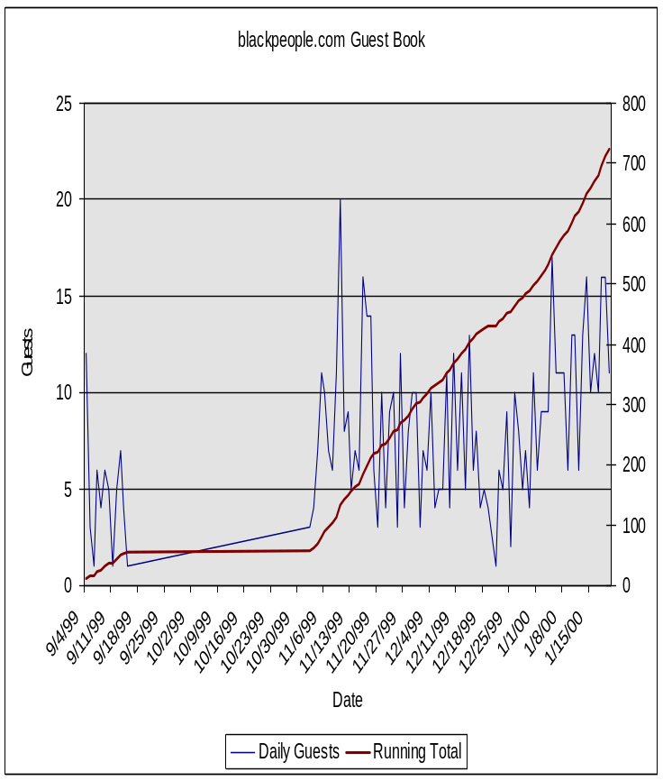
innercity
Current Projects: Electronic Chat
Affinity groups that discuss issues of particular interest: 128,000 weekly Visits on Black Facts Online alone!
EZ Info
Quality of Life Network
Software Developers Forum
Boston Blacks on Line
BlackPeople.com (BPC)
Black Facts Online

Slide 13

innercity
Current Projects: E-Commerce
Venture Capital Company Client Management System
Concept Development
Process Engineering
Web Site Design
Application Development
Training
On-going Assistance

Slide 14
innercity
Current Project: Electronic Magazine
Religious Organization Newsletter (500,000 members)
Low Maintenance Product for Publishers to place existing newsletter on-line.
  Easy to Update
  Streamlined for Faster Updates
Adaptable to provide a Catalogue for listing products supported by denomination leadership.
Target Market: New England through New York Market.

Slide 15
innercity
Current Customers
Massachusetts
  African American Federation
  Bessemer Venture Partners
  Black Data Processing Association
  Blackside Productions
  Boston’s Empowerment Zone
  Boston Oil Consumer’s Alliance
  Community Development Corporation of Boston
  Federated Dorchester Houses
  NESCAUM
  New England Black Pages
  Quality of Life Network
  T.A. Wilson Associates
  The Diversity Search Network
  The Museum of Afro American History
  Urban League of Eastern Massachustetts
  WBUR Radio (Boston’s NPR Affiliate)
  William Monroe Trotter Institute
Maryland
  Zenspace
New York
  New York Theological Seminary
New Jersey
  Positive Community News
Washington, D.C.
  Urban Hang Suite

Slide 16
innercity
Partner Benefits
Inside Track on Banking Opportunities created by ICS’s activities,
Strong Positive Publicity,
Potential Marketing Opportunity to existing initiatives.

Slide 17
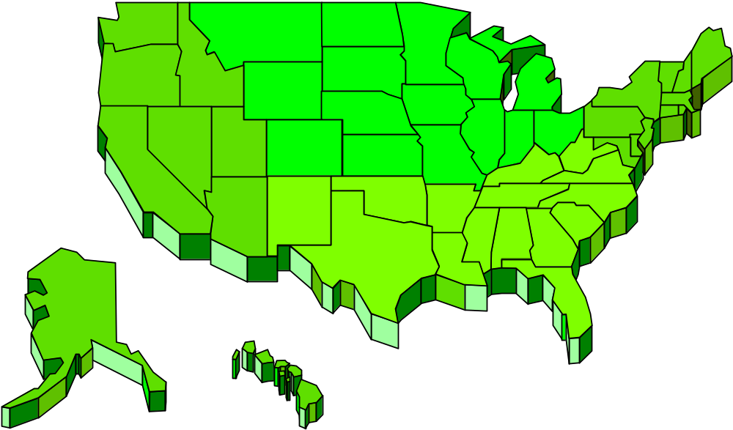
Locations
Current/Proposed Locations

